Slide 1

Predicting reasons for Car Accidents in UK

Slide 2
INTRODUCTION Road traffic injuries are one of the leading cause of death across many countries and are predicted to increase drastically in the coming years. The government and civic bodies need to understand what is the cause of such accidents. Hence a thorough data exploration and analysis is required to find the reasons for the same. An accurate prediction of the accidents can be predicted by analyzing factors like vehicles used, time of the day, gender of drivers, age of the drivers among many other factors. This project will help civic bodies and governments to find out the cause for these accidents and come up with various measures to curtail these accidents which are growing in number by the day,

Slide 3
DATA ACQUISITION AND DATA CLEANSING The data for road accidents is sourced from the https://data.gov.uk/ - road safety data ( https://data.gov.uk/dataset/cb7ae6f0-4be6-4935-9277-47e5ce24a11f/road-safety-data) Accidents data – 122635 cases across 32 features like location, geographic statistics, severity, light and weather conditions etc. Causalities Data : 160597 cases across 16 features like age of causality, sec of causality, etc. Duplicates and Null values were dropped Dropped unwanted values

Slide 4
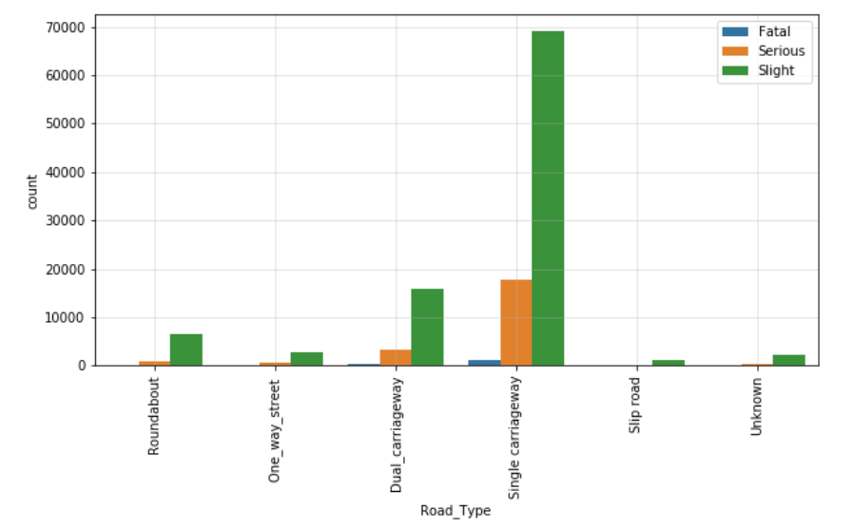
Accident Severity Based on Road type

Slide 5
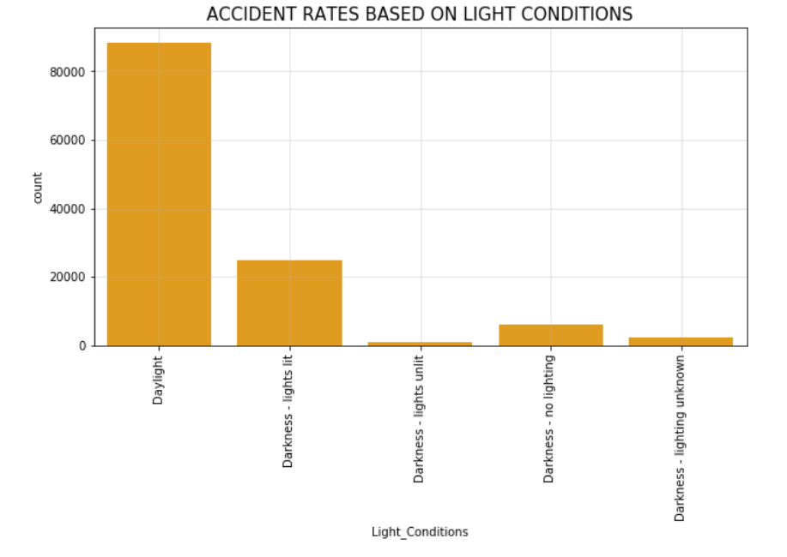
Accident Based on Weather Conditions

Slide 6
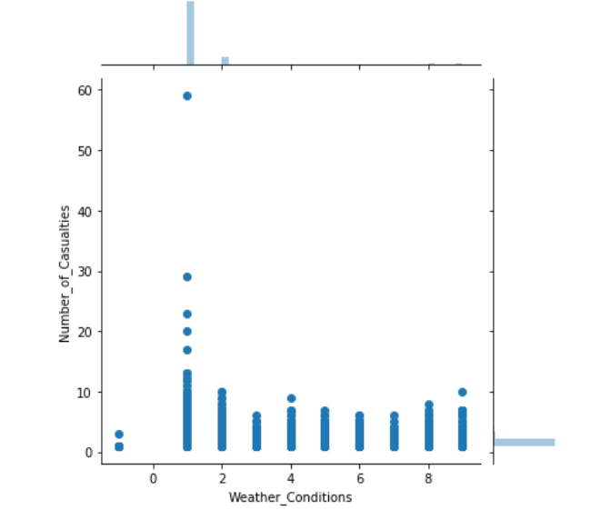
Causalities Based on Weather Conditions

Slide 7
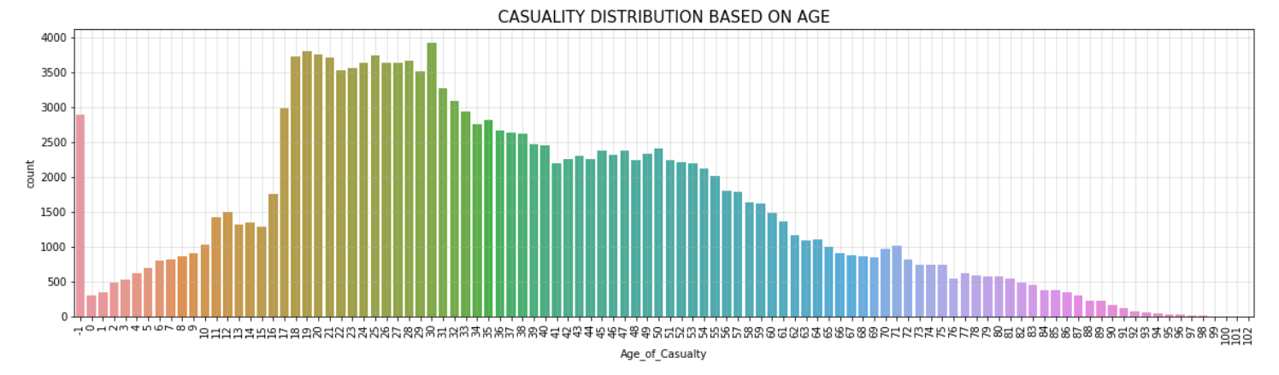
Causalities Distribution Based on Age

Slide 8
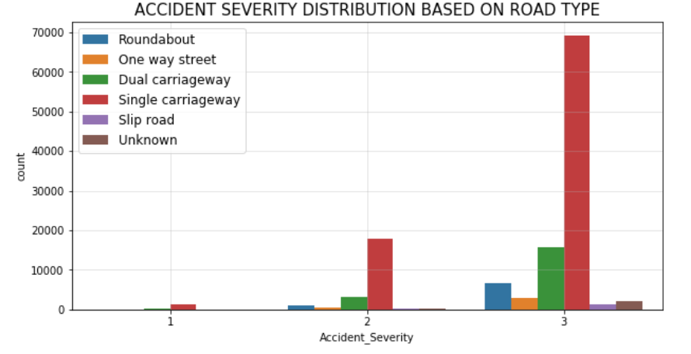

Slide 9
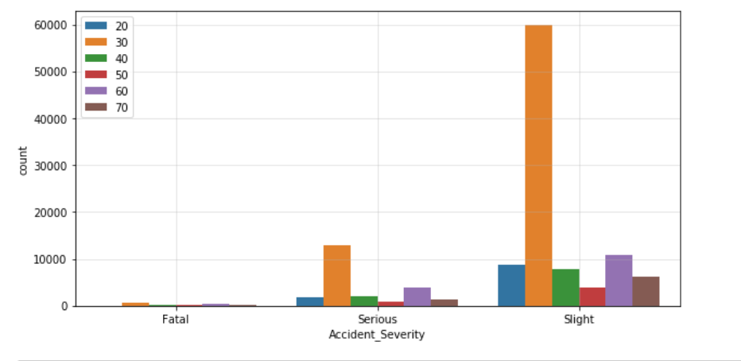

Slide 10
CONCLUSION The following observations are made from the analysis above : Many of the causalities which happened in accidents are mostly teenagers and youngsters around the age of 17-21 Many of the causalities suffered are males from every age groups Many of the accidents occurred in the region comes under the age group of 17-21 Many of the accidents are occurred in the daylight. Most of the accidents are due to Single Carriageway.

